Slide 1


Numerical Facet Range Partition: Evaluation Metric and Methods
Xueqing Liu¹, Chengxiang Zhai¹,
Wei Han², Onur Gungor²
¹Department of CS,
University of Illinois
²Walmart Labs

Slide 2
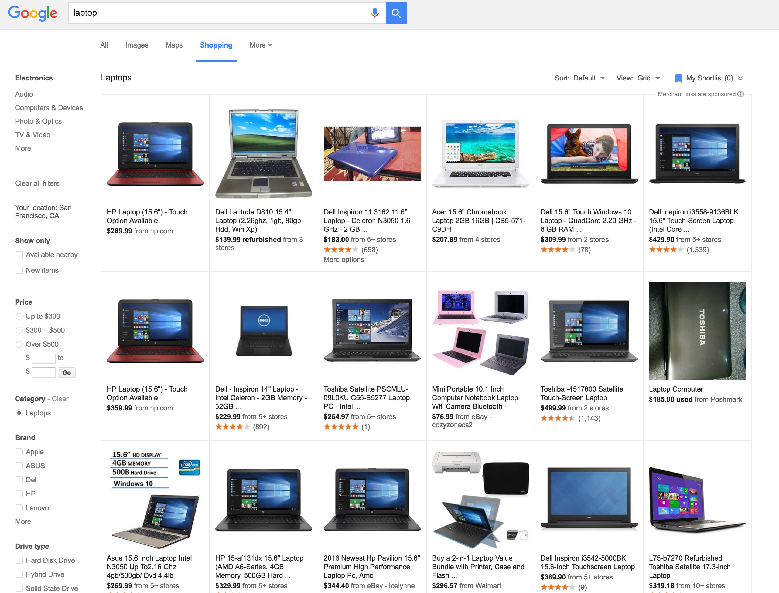
Faceted Search System
Query: “laptop”
Facets

Slide 3
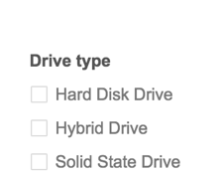
Faceted Search System
Query: “laptop”

Slide 4
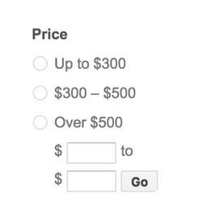
Faceted Search System
Query: “laptop”

Slide 5

Problem Definition
How to suggest k query-adaptable numerical ranges?

Slide 6

Is This Topic Too Narrow?

Slide 7

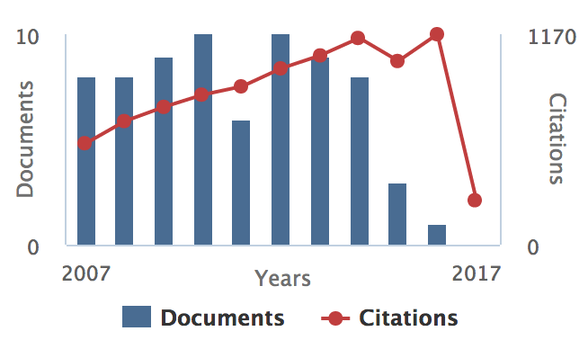


Is This Topic Too Narrow? No!
Video search
Academic search
News search
Location search

Slide 8
Why Unhappy with Current Websites?

Slide 9
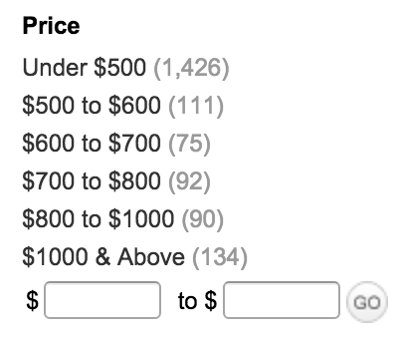
Why Unhappy with Current Websites?
Highly skewed distribution!
Query: “refurbished laptop”
1426/1928 = 73.9%

Slide 10
What Makes a Good Partition?

Slide 11
What Makes a Good Partition?
One that saves user’s browsing cost!
Notes:
≠

Slide 12
Browsing Cost under Partition
rank
2
5
3
1
4
item
price
150
200
250
300
400
relevant (clicked) item
irrelevant (not clicked) item

Slide 13
Browsing Cost under Partition
rank
2
5
3
1
4
item
price
150
200
250
300
400
ranges
180
350
e.g., [0, 180), [180, 350), [350, ∞)

Slide 14
Browsing Cost under Partition
rank
2
5
3
1
4
item
price
150
200
250
300
400
ranges
180
350
Assumption 1: user will select the unique range containing the relevant item

Slide 15
Browsing Cost under Partition
rank
5
3
1
item
price
200
250
300
ranges
180
350

Slide 16
Browsing Cost under Partition
rank
1
3
5
item
price
300
250
200
ranges
180
350
Assumption 2: after selecting the unique range, user will sequentially browse until finding the relevant item

Slide 17
Browsing Cost under Partition
rank
1
3
5
item
price
300
250
200
ranges
180
350
User browsing cost = 2

Slide 18

Evaluation Metric
User log contains n queries:
For each query q_{i}:
q₁, q₂, …, q_{n}
Cost (i) = rank of relevant item in its unique range
AvgCost = 1/n Cost (i)
i

Slide 19
Method 1: Dynamic Programming
Optimize expected Cost(i)
rank
2
5
3
1
4
item
price
150
200
250
300
400

Slide 20
A Simple Baseline
Quantile method: making each range contain same number of items
2
5
3
1
4
150
200
250
300
400

Slide 21
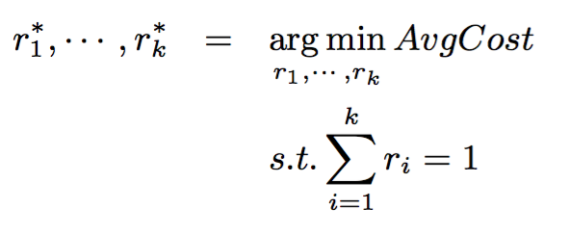
Learning to Partition
Parameter: r_{i} = proportion of items in range i
Quantile method: r_{i} = 1/k, i=1,2,…,k

Slide 22
Learning to Partition
AvgCost is Non-smooth!
e.g., r₁, r₂ = [0.8, 0.2]
2
5
3
1
4
150
200
250
300
400
Cost(i) = 3

Slide 23
Learning to Partition
AvgCost is Non-smooth!
e.g., r₁, r₂ = [0.8-ε, 0.2+ε]
2
5
3
1
4
150
200
250
300
400
Cost(i) = 2

Slide 24
Learning to Partition
AvgCost is Non-smooth!
Non-smooth optimization of AvgCost is time-consuming
Introducing surrogate function:
O(N_{eval}mnlogm)
O(mnlogm + N_{eval}klogm)

Slide 25
Partition by Different Parameters
So far, we have been using the same parameters on different queries
What if different queries have different parameters?
Decision tree
refurb=F
refurb=T
r₁,r₂=[0.3,0.7]
r₁,r₂=[0.7,0.3]

Slide 26
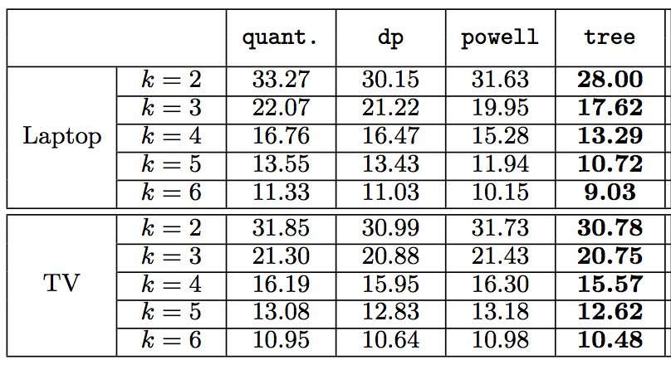
AvgCost
quant.: quantile method dp: dynamic programming
powell: same parameter tree: different parameter

Slide 27
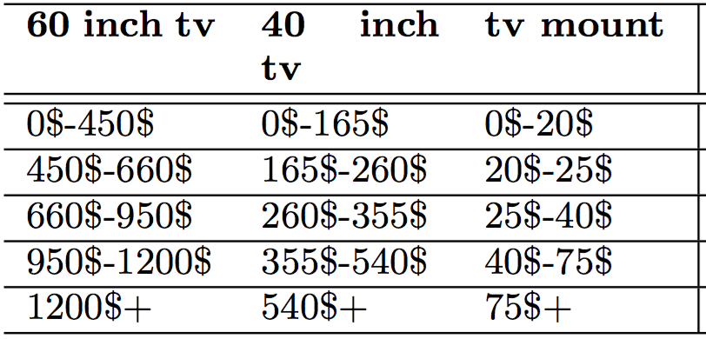
Example Ranges

Slide 28
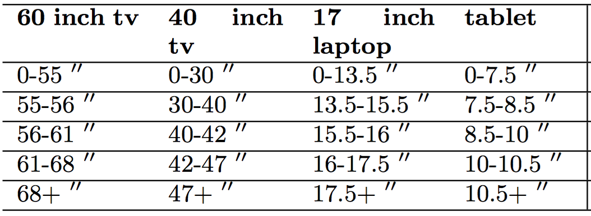
Example Ranges

Slide 29
Conclusion
Propose a new research problem
Propose two algorithms
Especially helpful for diverse inventory, e.g., eBay
Future Work
Generating ranges based on user feedback

Slide 30




Q & A
xliu93@illinois.edu
Xueqing Liu
Chengxiang Zhai
Wei Han
Onur Gungor

